Slide 1
What Made the Venture Capital fund these Startups?
--Influence of social media & Seed accelerator
SHU LIU

Slide 2
Initial Analysis:
(1)Seed Accelerator:
The early period of a startup is the crucial part of its success. Seed Accelerators provide mentorship and funding support.
[Born]
(2)Social Media:
Social Media is a indirect index of the number of users, which is one of the most important factor when valuating an online company.
Relative Valuation -> Relative company (similar developing trend)
[Growth]

Slide 3
Data Source:
Extracted from:
Seed-DB.com using Webscraping,
and Twitter using Tweepy API
Variables Selection:
Startups (funding > 1 million) and corresponding Seed Accelerators :

Slide 4
Variables
Startup (funding > 1 million):
name, website, number of followers, number of friends, number of statuses, amount of funding, rounds of funding
Seed Accelerator :
name, address, established year, website, amount exited, amount funded, number of startups exited, number of startups funded

Slide 5
Startups

Slide 6
Startups
seed_accelerator accel_estb_yr name funding
1 Y Combinator 2005 AirBnb 3394820000
2 Y Combinator 2005 Dropbox 1107215000
3 Y Combinator 2005 Zenefits 583600000
4 Techstars Boulder 2007 DigitalOcean 305405800
5 Y Combinator 2005 Stripe 290000000
6 Y Combinator 2005 Instacart 274800000
7 Y Combinator 2005 DoorDash 186700000
8 Y Combinator 2005 Gusto 161100000
9 Y Combinator 2005 Ginko Bioworks 154120000
10 NYC SeedStart NA DataDog 147900000

Slide 7
Seed Accelerator

Slide 8
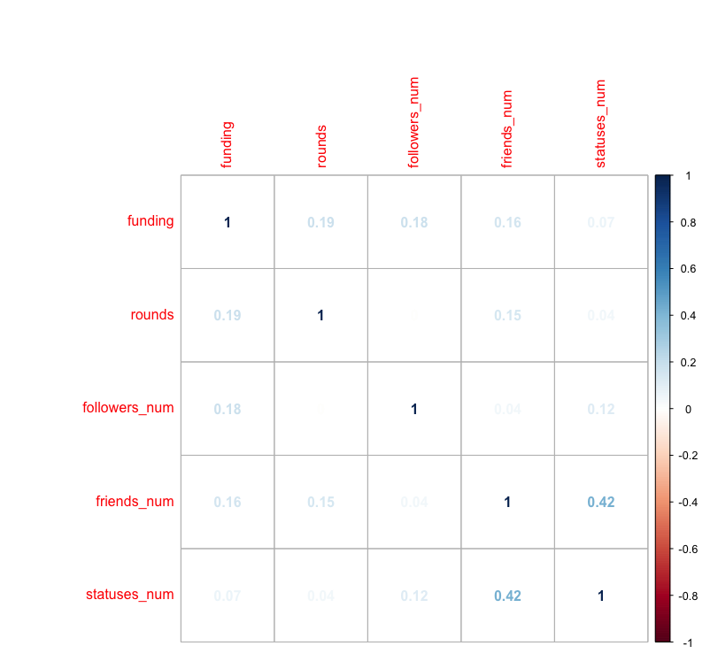
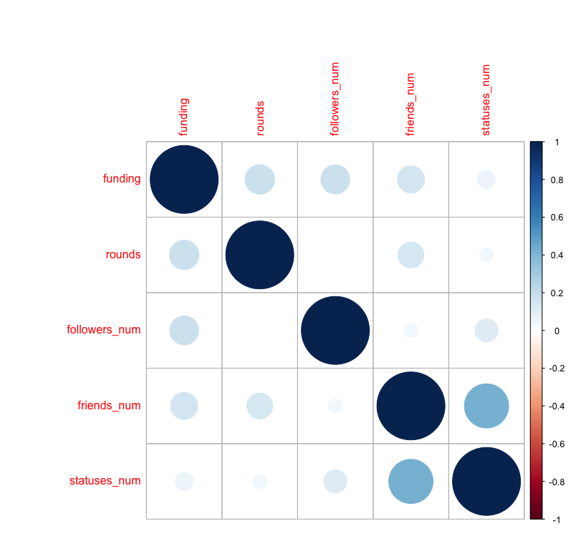
Social Media
Twitter.

Slide 9
Next step: Model
Depend variables: Funding Amount/rounds
Independent Variables:
Seed factor (year, state, amount funded(number of startups funded) )
&
Users factor (number of followers)

